Slide 1
MAGIC BULLET THEORY OR HYPODERMIC NEEDLE THEORY

Slide 2
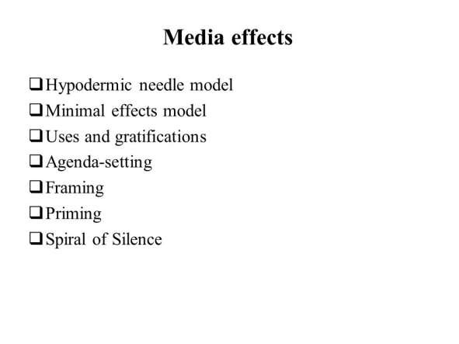
MEDIA EFFECTS THEORIES

Slide 3
MAGIC BULLET THEORY
Its also called as ‘Hypodermic Needle Theory’
Proposed by Harold Lasswell in 1920
It was discussed in the book ‘Propaganda Technique’ The theory was used by Germany and US in WW-II It’s a linear model of communication
Talks about media’s power on audience

Slide 4
HYPODERMIC NEEDLE THEORY
The message is like a magic bullet
It explains how media controls the audience views
Berger, 1995 -Media’s ‘message is a bullet’ fired from the ‘media gun’ into the viewer’s head
Mass is influenced directly and at the same time Messages injected can have the desired response Destruction the order and uniformity of society

Slide 5
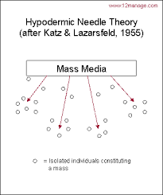
HYPODERMIC NEEDLE THEORY

Slide 6
CORE ASSUMPTIONS
Humans are believed to act uniformly
Media inject or inserts messages like a bullet
Messages having their own intention and get desired outcomes
The effect is supposed to be strong, immediate and dangerous
Mass is made to think in media lines
The audience is always vulnerable and passive

Slide 7
EVIDENCE
In 1938, ‘Panic broadcast’ was happened in Radio drama in New Jersey
In 1940, The German leaders used movie industry to show their power and unify the people
The gender role concept has also been injected in every person’s mind

Slide 8
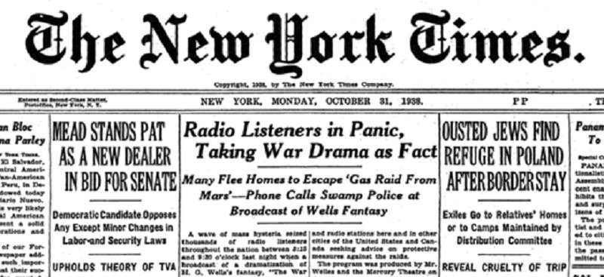
CRITICISM

Slide 9
CRITICISM
It’s a linear model of communication
The audience is passive and easily influenced by the messages
Theory has been proved to fail by many studies like “The People’s Choice”- recent US elections in 2016
The theory is not taken as empirical

